Slide 1


Abstract Writing
张海波 BY2005411
骆 明 BY2005319
李永昌 BY2005313
杨云熙 BY2005116
田博皓 BY2007126
金 晶 BY2005308
2021年04月20日

Slide 2
Abstract Writing
Contents
The Purpose of an Abstract
How to Write an Abstract：
A General Template for an Abstract
Tips for Translation
When You Write Other Types of Abstracts

Slide 3
The Purpose of an Abstract
Purpose
Template
Translation
Other Types
To summarize the whole article
It allows readers to quickly get the key information of the research without reading the full article.
To attract your counterparts in online databases
It allows researchers in your field to quickly find this article.

Slide 4
How to Write an Abstract
Start with a simple case
Purpose
Template
Translation
Other Types
In forward flight, slowing down a rotor alleviates compressibility effects on the advancing side blade tip, extending the cruise speed limit, and inducing high-advance-ratio flight regime. Previous wind tunnel tests have shown that an articulated rotor trimmed to zero hub moment generates limited thrust at high advance ratios, because the advancing side needs to be trimmed against the retreating side with significant reverse flow, where the rotor is ineffective in generating thrust. A rigid hingeless rotor with lift offset may help overcoming this problem. A series of wind tunnel tests were conducted to investigate the behavior of slowed hingeless rotors at high advance ratios. Performance, control angles, hub vibratory loads, and blade structural loads were measured and compared with comprehensive analysis predictions. The results demonstrate that a hingeless rotor with lift offset is more efficient in generating thrust and exhibits higher lift-to-drag ratio at high advance ratios. The blade structural load level is significantly higher compared with an articulated rotor, especially its 2/rev flap bending moment, which can pose a critical structural constraint on the rotor.
Source：Wang X , Bauknecht A , Maurya S , et al. Slowed Hingeless Rotor Wind Tunnel Tests and Validation at High Advance Ratios[J]. Journal of Aircraft, 2020, 58(24):1-14.
Introduction
(Background
+Problem)
Method
Result
Discussion

Slide 5
How to Write an Abstract
Purpose
Template
Translation
Other Types
for a Research Article：
Give the Introduction, Method, Results and Discussion.
A sampling survey consisting of 10 abstracts was conducted to show the typic structure* of research article abstracts.
1：Find a suitable framework
2：Fill in the content
*It could be atypical in Humanities and Social Science, where a separate analysis section is usually separated out.

Slide 6
How to Write an Abstract
Purpose
Template
Translation
Other Types
A General Framework：
established with IMRD move
classified as 5 parts: background, problem, method, result, and discussion.
Based on the survey results and some linguistic research results, some templates are given to help you write these moves.
Typical Length of an Abstract：150-250 words.
(for research articles in engineering/natural science journals)

Slide 7
How to Write an Abstract
Purpose
Template
Translation
Other Types
Background：
Recently, there has been a growing interest in …
Pay attention to adding a subject if you don’t use the “there be” statement.
… plays a critical role in the maintenance of …
It has previously been observed that …
Previous research has established that …

Slide 8
How to Write an Abstract
Purpose
Template
Translation
Other Types
Problem：
However, little has been done on ...
Little previous study has investigated ...
The use of … has not been investigated systematically.
There has been no detailed investigation of …
expression of limitations：
little \ scant \ limited \ few \ …
When you use “no”, pls check whether your tone is too strong. Other limited descriptions are usually suggested.

Slide 9
How to Write an Abstract
Purpose
Template
Translation
Other Types
Method：
In this paper, we use … method for the problem.
A … model/method/algorithm is developed/used/proposed to represent …
Result：
It is found that …
… shows/demonstrates/illustrates/indicates/suggests that …

Slide 10
How to Write an Abstract
Purpose
Template
Translation
Other Types
Discussion：
… is significantly higher/better compared with …(结果对比)
This work demonstrates the potential of …(研究意义)
The results can be used for …(用途启示)
Model results also suggest benefits for …
It is anticipated that the conceptual model presented here will be used as a basis for …
These models provide a viable alternative to …

Slide 11
How to Write an Abstract
Purpose
Template
Translation
Other Types
Case
①Recently, there has been a growing interest in …②It has shown great potential in ... ③However，there is still a lack of systematic research on … ④This article mainly uses … methods to …⑤The results demonstrate that … ⑥ These models provide a viable alternative to …
①②Background
③Problem
④Method
⑤Results
⑥Discussion

Slide 12
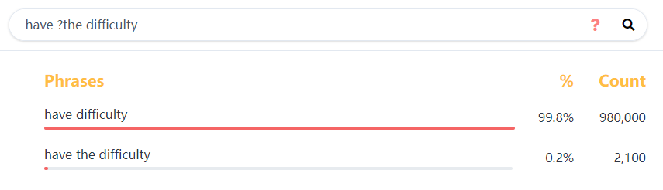
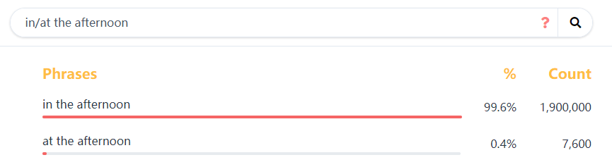
How to Write an Abstract
Purpose
Template
Translation
Other Types
more template in Academic Phrasebank
Check your vocabulary collocation at Linggle
To Fill in the content：
Translate your work into English.
Then use templates to connect your sentences.

Slide 13
Tips* for Translation
Purpose
Template
Translation
Other Types
To Fill in the content：
Translate your work into English:
1：Use transition words.
2：Remove redundant expressions.
3：Apply the idiomatic tense and voice.
4：Try to formalize the text.
*It must be emphasized that all these recommendations are not absolutely applicable and are for reference only.

Slide 14
Tips for Translation
Purpose
Template
Translation
Other Types
1：Use transition words：
Avoid using commas or periods instead of transition words as that in Chinese.
Because of the space limitations and habits, some common connectives in everyday English may be excluded from the selection.
Not recommended：
firstly，secondly，finally
on the basis of this

Slide 15
Tips for Translation
Purpose
Template
Translation
Other Types
1：Use transition words：
Recommended：
递进、增补：
and，also，too，furthermore，besides，in addition，moreover
转折、对比：
but，though，yet，still，however，nevertheless，instead
因果：
for，therefore，thus，so，(and)
总结、推论：
in conclusion/short/a word，briefly

Slide 16
Tips for Translation
Purpose
Template
Translation
Other Types
2：Remove redundant expressions：
“detailed analysis”“extensive investigation”
Subjective expression is not common in academic writing.
Especially avoid judging your work. 对中文写作同样适用。

Slide 17
Tips for Translation
Purpose
Template
Translation
Other Types
3：Apply the idiomatic tense and voice：
The most frequent tense：
the simple present tense：background，conclusion
the simple past tense：method，result
the present perfect tense：emphasize the implications
However, there has been a tendency to use the simple present tense throughout the writing of papers, which enhanced the freshness of information and improved the reading experience.

Slide 18
Tips for Translation
Purpose
Template
Translation
Other Types
3：Tense：
Background(Present Tense/Present Perfect Tense)
Example：One of the basic principles of communication is that …
There has been a growing interest in …
Method(Past Tense)
Example：We developed a method to …
Results(Past Tense)
Example：The model proved to be more durable than …
Discussion(Present Tense)
Example：Model results also suggest benefits for …

Slide 19
Tips for Translation
Purpose
Template
Translation
Other Types
3：Apply the idiomatic tense and voice：
active voice vs. passive voice
Active voice：interaction，readability
Passive voice：objectivity
Recommended situations for passive voice：
中文中“无主句”、动宾短语单独成句的翻译：开发了…，提出了…，推导了….
Emphasize concepts，issues，facts，conclusions

Slide 20
Tips for Translation
Purpose
Template
Translation
Other Types
3：Apply the idiomatic tense and voice：
Recommended situations for active voice：
humanities and social science
computer science，electronic information science，etc.
when the writing/submission guide recommends the use of active voice
Subject choice：
This article/paper
We，(I)
This may be considered as a "redundant expression" in some journals.

Slide 21
Tips for Translation
Purpose
Template
Translation
Other Types
3：Active Voice：
Example：
…….This article reports of the dynamics of replacing project managers, identifying the critical decision criteria and mechanisms involved in such decisions. We found that three themes emerged with regard to project manager replacement decision making: 1) replacement is a common correction practice for troubled projects; ……
Source：Davis K , Maddaloni F D , Pinto J K . Drawing New Cards or Standing Pat: Antecedents, Dynamics, and Consequences of Project Manager Replacement[J]. IEEE Transactions on Engineering Management, 2021, PP(99):1-23.

Slide 22
Tips for Translation
Purpose
Template
Translation
Other Types
4：Try to formalize the text：
Some words that might make the text seem more formal：
严肃用语和书面用语
large→enormous
get→understand→comprehend
A and its B→A and B thereof(类似there衍生还有thereby(从而)等)
避免使用缩写
it’s→it is/has
用单个词汇替换(动词)短语
set up→establish

Slide 23
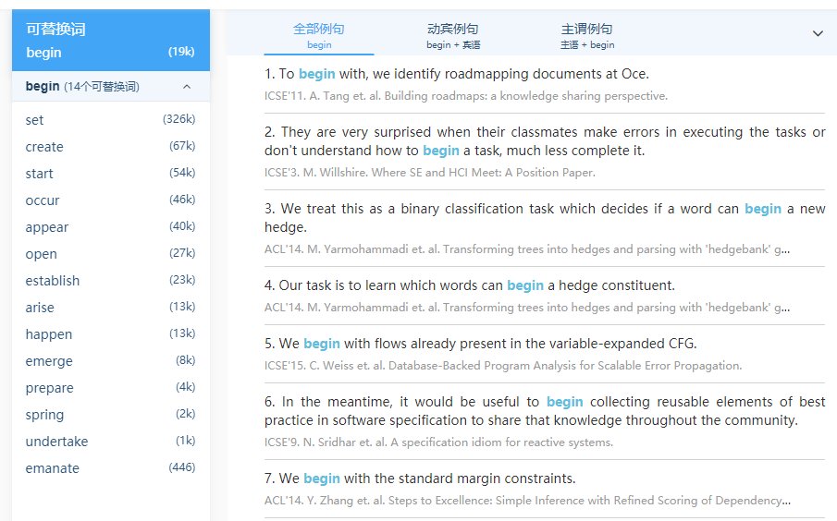
Tips for Translation
Purpose
Template
Translation
Other Types
4：Try to formalize the text：
To avoid repetition, sometimes written language cannot be used multiple times.
Maybe you need to find synonyms and usages thereof.
易搜搭

Slide 24
When You Write Other Types of Abstracts
Purpose
Template
Translation
Other Types
Types of abstract:
Informative abstracts 信息型(most common)
Descriptive abstracts 描述型
Structured abstracts 结构型
…
Critical abstracts 评论型
Highlight abstracts 突出型
Graphical, video and animated abstracts 形象型/视觉型
Rare

Slide 25
When You Write Other Types of Abstracts
Purpose
Template
Translation
Other Types
Descriptive abstracts
merely indicate the content of an article
application and value are more limited
generally used for humanities and social science or psychology
usually very short (50-100 words)
contains fewer moves: background，purpose，focus

Slide 26
When You Write Other Types of Abstracts
Purpose
Template
Translation
Other Types
Descriptive abstracts
Example：
The purpose of this program is to provide generalized crack growth tracking procedures for transport bomber aircraft.【purpose】 A study and tests were conducted on crack growth rate characteristics, analysis schemes were developed, and tracking procedures were evaluated.【focus of paper】
(37 words)

Slide 27
When You Write Other Types of Abstracts
Purpose
Template
Translation
Other Types
Structured abstracts
clear subtitles for each section
generally used for medicine, biology, biological engineering, and physiology field.
generally longer than informative abstracts
The name of the subtitle depends on the requirements of the journal.

Slide 28
When You Write Other Types of Abstracts
Purpose
Template
Translation
Other Types
Structured abstracts
Example：
Background: Drafting in cetaceans is defined as the transfer of forces between individuals without actual physical contact between them. This behavior has long been surmised to explain how young dolphin calves keep up with their rapidly moving mothers. It has recently been observed that a significant number of calves become permanently separated from their mothers during chases by tuna vessels. A study of the hydrodynamics of drafting, initiated in mechanisms causing the separation of mothers and calves during fishing-related activities, is reported here.
Results: Quantitative results are shown for the forces and moments around a pair of unequally sized dolphin-like slender bodies. These include two major effects. First, the so-called Bernoulli suction, which stems from the fact that the local pressure drops in areas of high speed, results in an attractive force between mother and calf. Second is the displacement effect, in which the motion of the mother causes the water in front to move forwards and radially outwards, and water behind the body to move forwards to replace the animal's mass. Thus, the calf can gain a 'free ride' in the forward-moving areas. Utilizing these effects, the neonate can gain up to 90% of the thrust needed to move alongside the mother at speeds of up to 2.4 m/s. A comparison with observations of eastern spinner dolphins is presented, showing savings of up to 60% in the thrust that calves require if they are to keep up with their mothers.
Conclusions: A theoretical analysis, backed by observations of free-swimming dolphin schools, indicates that hydrodynamic interactions with mothers play an important role in enabling dolphin calves to keep up with rapidly moving adult school members.
Source：Weihs D . The hydrodynamics of dolphin drafting[J]. Journal of Biology, 2004, 3(2):8.

Slide 29
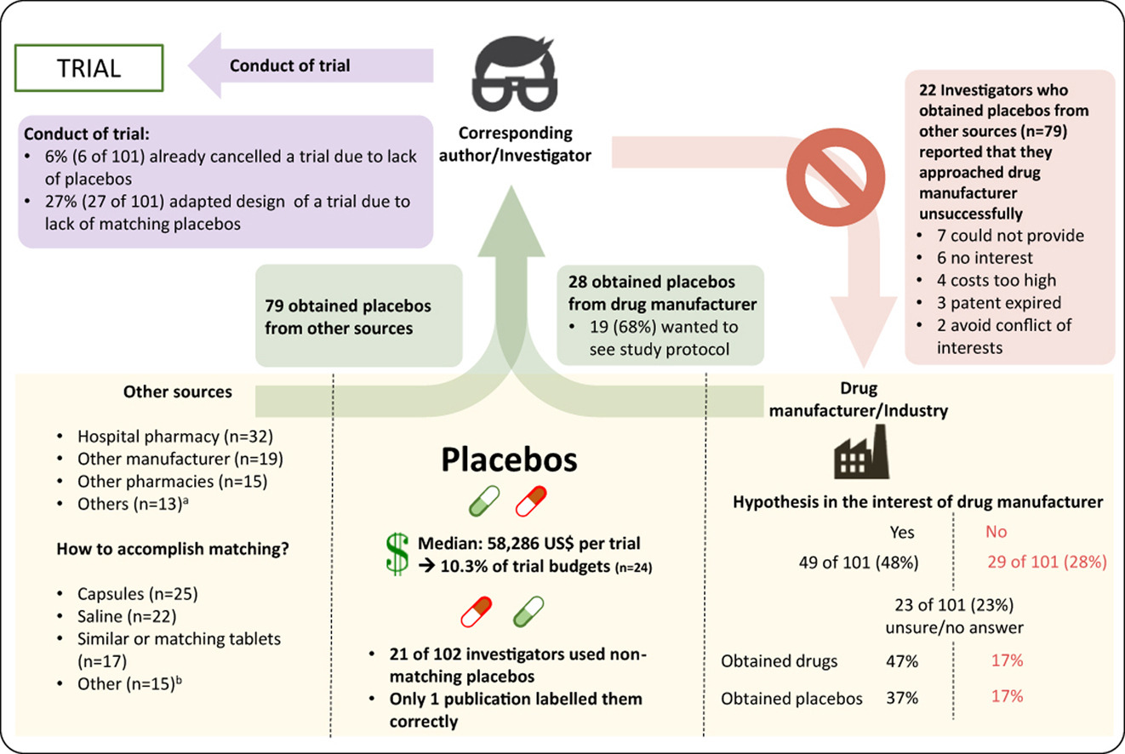
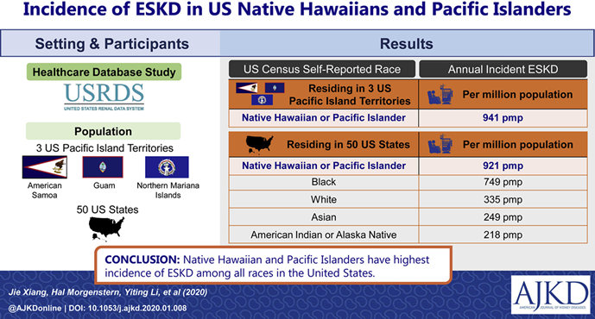
When You Write Other Types of Abstracts
Purpose
Template
Translation
Other Types
Graphical, video and animated abstracts
a single, concise, pictorial and visual summary of the main findings of the article
captures the content of the article for readers at a single glance

Slide 30
When You Write Other Types of Abstracts
Purpose
Template
Translation
Other Types
Conference Abstract
Usually needs to be completed several months before the official report.
To promote the research work and to attract peoples to participate in discussions or watch your posters.
Main readers：review committee，other participants
writing quality
fitness of theme
novelty of content
relevance of work
novelty of content

Slide 31
When You Write Other Types of Abstracts
Purpose
Template
Translation
Other Types
Conference Abstract
Emphasize key words that are relevant to the topic of the conference
Make sure that you have followed the requirements of the call for paper (Template，Words limit，Diagrams，…)
If your research has not been completed：
Focus on describing background and methods；
Give your expected progress and result；
Make sure that the author(s) will have a strong likelihood of completing the final manuscript by the final manuscript submission deadline.

Slide 32
Summary
Purpose
Summarize the article + attract your counterparts
Template
1：IMRD moves: Introduction(Background+Problem)→Method→Results→Discussion
2：text length analysis
3：typical expression for each move
4：template library: Academic Phrasebank
5：collocation check: Linggle

Slide 33
Summary
Translation
1：transition words
2：redundant expressions
3：tense and voice
4：written words and repetition
Types of Abstracts
1：informative abstracts (most common)
2：descriptive abstracts (short version)
3：structured abstracts (subtitle)
4：graphical, video and animated abstracts (trend)

Slide 34
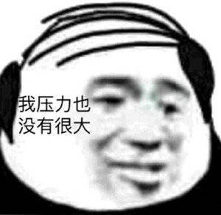
Summary
Conference Abstract
1：emphasize key words about topic
2：follow the requirements of the call for paper
3：ensure that all work could be completed before the deadline
祝愿各位博士同学：
头发少掉，PAPER多发~

Slide 35
Reference
[1] Glasman-Deal H . Science research writing for non-native speakers of English[M]. Imperial College Press, 2009.
[2] 余莉, 陈洁, 梁永刚. 学术英语写作[M]. 北京：清华大学出版社, 2015.
[3] Jacinto T, van Helvoort H, Boots A, et al. Doing science: writing conference abstracts[J]. Breathe, 2014, 10(3): 265-269.
[4] Simkhada P, Van Teijlingen E, Hundley V, et al. Writing an abstract for a scientific conference[J]. Kathmandu University Medical Journal, 2013, 11(3): 262-265.
[5] 钱多秀, 罗媛. 基于语料库的论文摘要语步的对比研究[J]. 北京科技大学学报(社会科学版), 2014, 30(02): 12–17.
[6] 徐婉洁, 陈舟. 基于IMRD语步分析的土木工程论文英文摘要研究[J]. 黑龙江工业学院学报(综合版), 2019, 19(01): 100–105.
[7] BUAA学术论文写作.英语学术论文摘要写作(I)：确定结构内容：https://mp.weixin.qq.com/s/MW9JCNmSf_65xwuNUM-6dQ
[8] BUAA学术论文写作.英语学术论文摘要写作(II)：学会运用预制语块：https://mp.weixin.qq.com/s/F3XCSNJbR8-HZLn_A0Kigw
[9] BUAA学术论文写作.英语学术论文摘要写作(III)：几个英汉对比凸显的问题：https://mp.weixin.qq.com/s/fT5ZT7nYjqPZwCEpZtkRMA
[10] 夏历, 郭巍.英文学术论文写作改评析[M]. 北京：北京航空航天大学出版社，2020.
[11] CSU写作指导网站：https://writing.colostate.edu/guides/page.cfm?pageid=1252&guideid=59
[12] UCS写作指南：https://libguides.usc.edu/writingguide/abstract
[13] 维基百科：Abstract：https://en.wikipedia.org/wiki/Abstract_(summary)

Slide 36
Reference
[14] Kaplan R B, Cantor S, Hagstrom C, et al. On abstract writing[J]. Text-interdisciplinary Journal for the Study of Discourse, 1994, 14(3): 401-426.
[15] 威斯康辛大学写作中心：https://writing.wisc.edu/handbook/assignments/writing-an-abstract-for-your-research-paper/[6] https://wordvice.com/how-to-write-a-research-paper-abstract/
[16] 阮淑俊.科技期刊论文摘要汉译英中的主要问题及对策[J].今传媒,2021,29(2):79-81.
[17] 夏历. 中、英文科技论文摘要的研究综述[J]. 东莞理工学院学报, 2015, 22(6):57-63.
[18] Academic Phrasebank：https://www.phrasebank.manchester.ac.uk/
[19] Linggle：https://www.linggle.com/
[20] 易搜搭ESODA：http://www.esoda.org/

Slide 37
THANKS
BEIHANG UNIVERSITY
2021.4.20

Slide 38
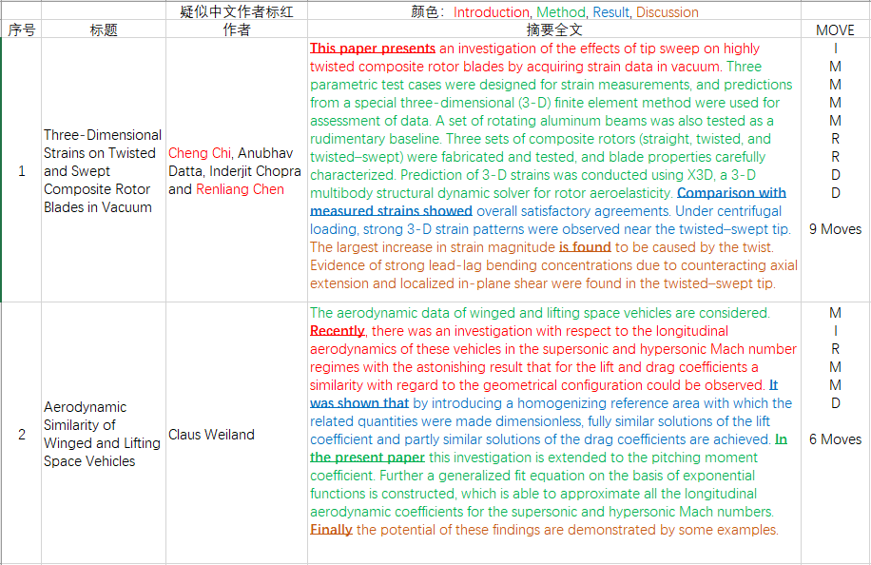
How to Write an Abstract

